Slide 1

Smart Garden
Bridget Harrington, Kara Vitale, David Wieczorek

Slide 2
Any Green Thumbs? How do You keep a Successful Garden when you’re too busy to keep checking on it?

Slide 3

With our Smart Garden!
The smart garden would detect and display moisture and UV statistics for a successful garden!

Slide 4
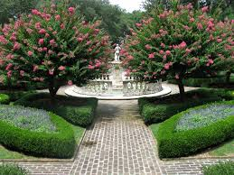
Proposed Solution:
A solar charged device that sticks into the garden. It will send data from moisture and UV sensors and send that to an app on your phone. The app will send alerts at critical points (i.e. under/over watering). The app will also be able to provide a picture of the current state of the garden if requested.

Slide 5
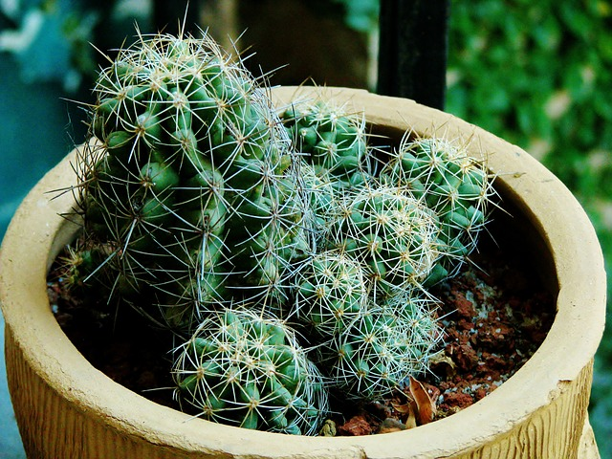
Demonstrated Features:
Moisture Detection
Solar Charging
Multi Plant Use
UV Exposure Tracking
“Garden View”
Communication to an App
User Alerts at Critical Levels

Slide 6
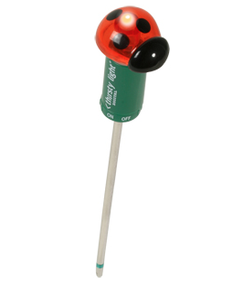
Available Technologies
Moisture Sensor
Solar Battery Charger
Small Camera
UV Sensor
Battery
WiFi Module

Slide 7
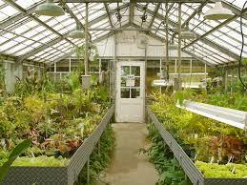
Engineering Content:
Sensors
Moisture
UV
Power
Solar Charging
Batteries
WiFi
Connecting it all
Using WiFi outside
Mobile App
Sensor Data → App
Tracking Multiple Plants

Slide 8
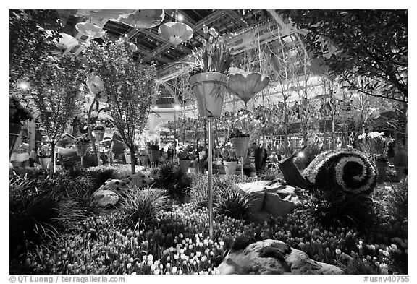
Thanks For Listening!

